Slide 2

Topics
Introduction to Repetition Structures
The while Loop: a Condition-Controlled Loop
The for Loop: a Count-Controlled Loop
Calculating a Running Total
Sentinels
Input Validation Loops
Nested Loops

Slide 3
Introduction to Repetition Structures
Often have to write code that performs the same task multiple times
  Disadvantages to duplicating code
    Makes program large
    Time consuming
    May need to be corrected in many places
Repetition structure: makes computer repeat included code as necessary
  Includes condition-controlled loops and count-controlled loops

Slide 4
The while Loop: a Condition-Controlled Loop
while loop: while condition is true, do something
  Two parts:
    Condition tested for true or false value
    Statements repeated as long as condition is true
  In flow chart, line goes back to previous part
  General format:
    while condition:
    statements

Slide 5
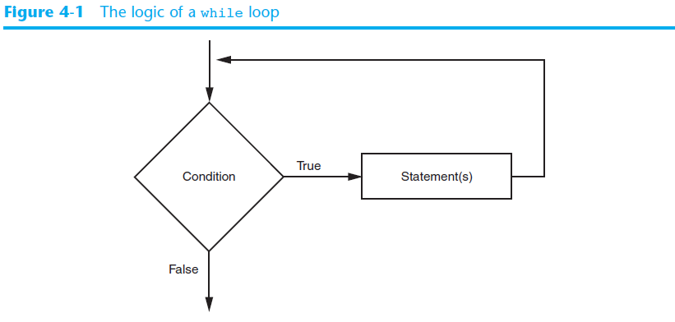
The while Loop: a Condition-Controlled Loop (cont’d.)

Slide 6
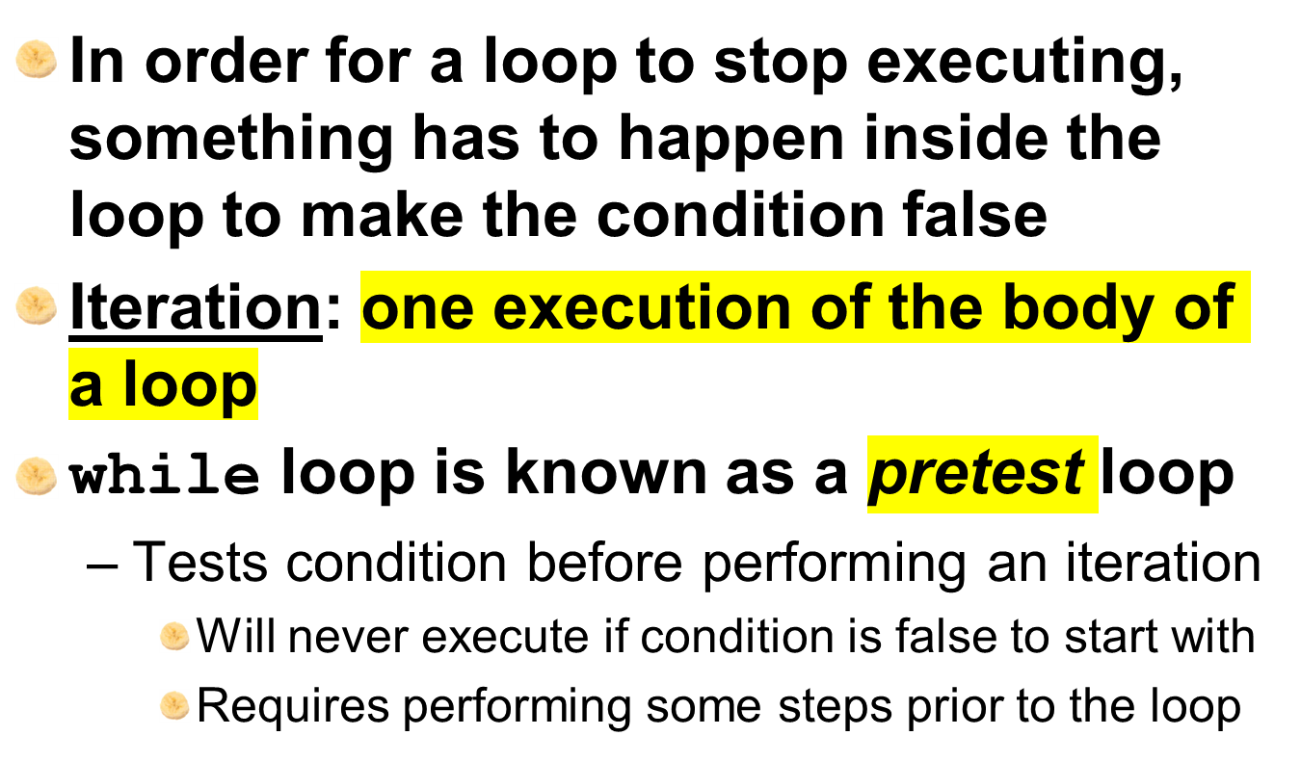
The while Loop: a Condition-Controlled Loop (cont’d.)

Slide 7
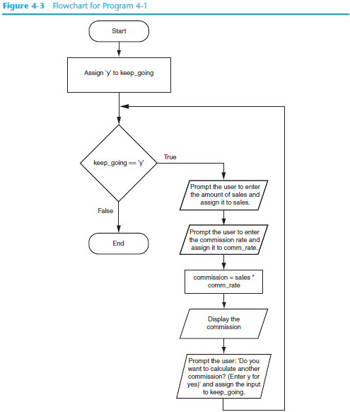

Slide 8
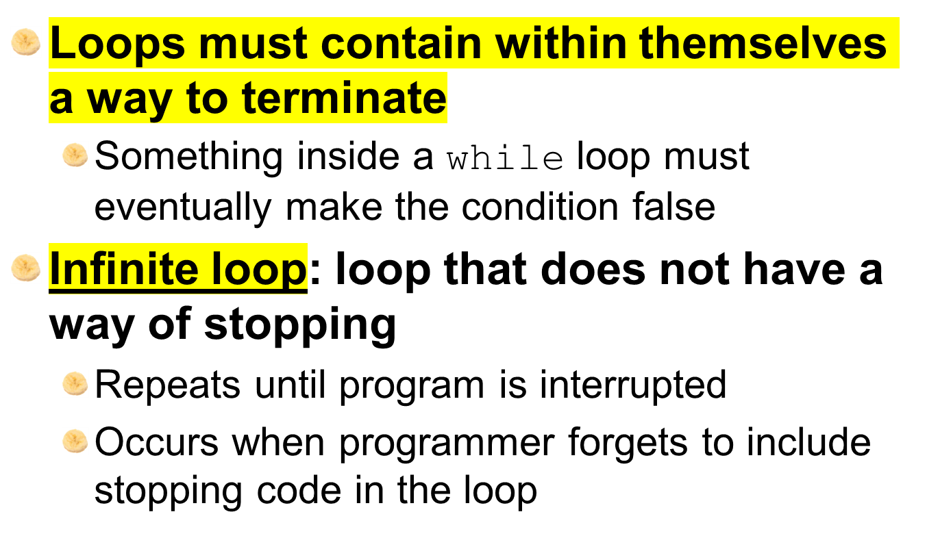
Infinite Loops

Slide 9

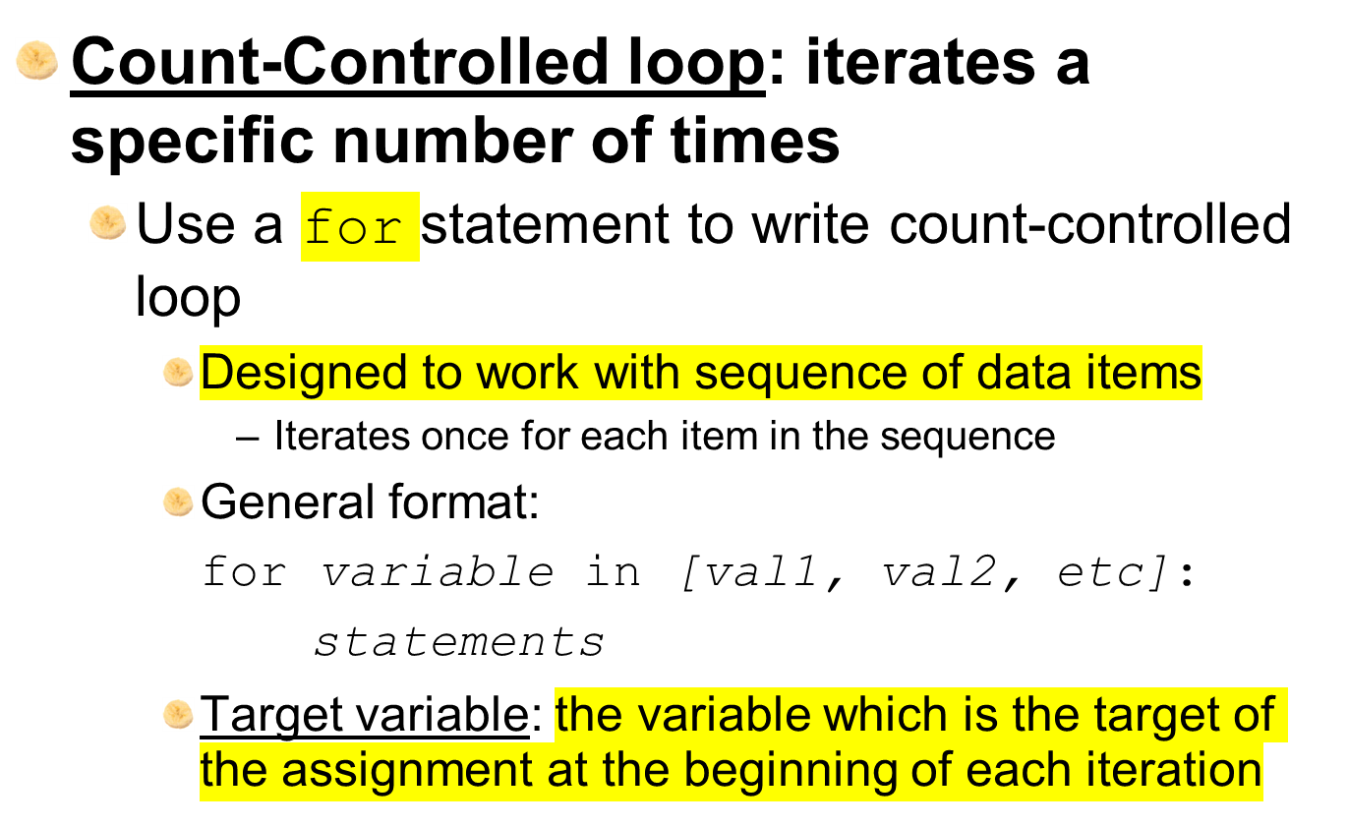

Slide 10
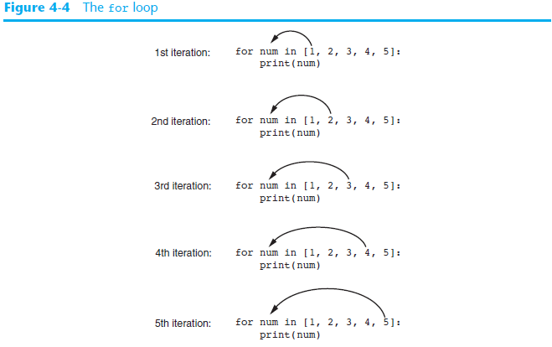

Slide 11
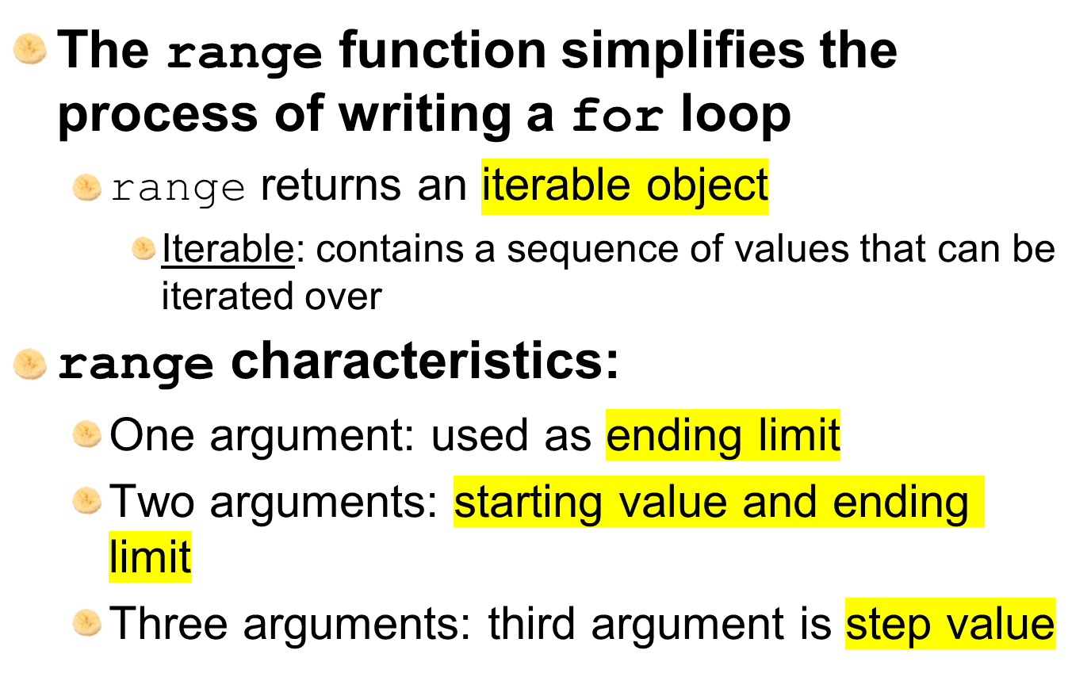
Using the range Function with the for Loop

Slide 12
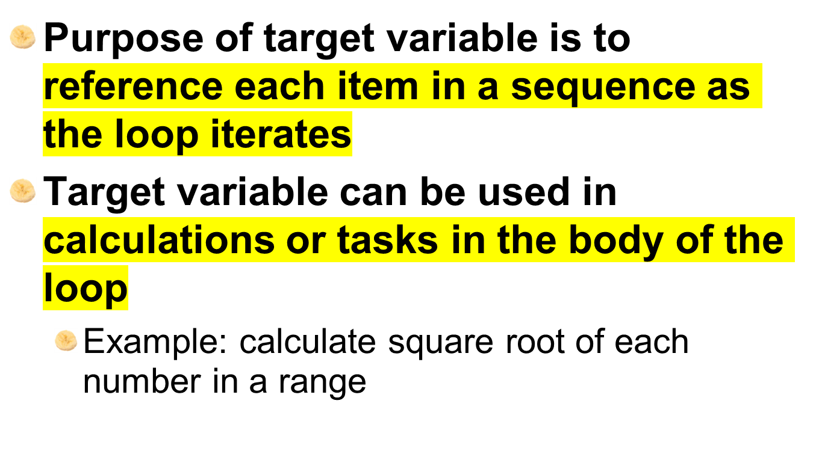
Using the Target Variable Inside the Loop

Slide 13
Letting the User Control the Loop Iterations
Sometimes the programmer does not know exactly how many times the loop will execute
Can receive range inputs from the user, place them in variables, and call the range function in the for clause using these variables
  Be sure to consider the end cases: range does not include the ending limit

Slide 14
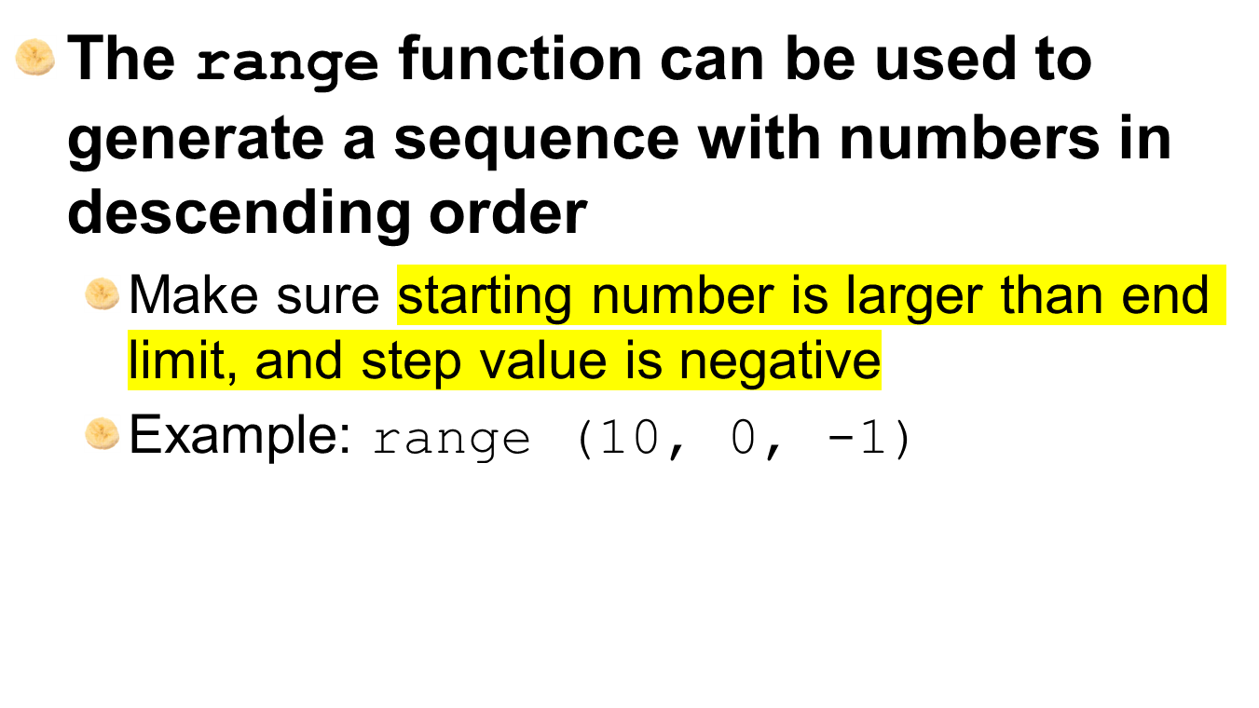
Generating an Iterable Sequence that Ranges from Highest to Lowest

Slide 15
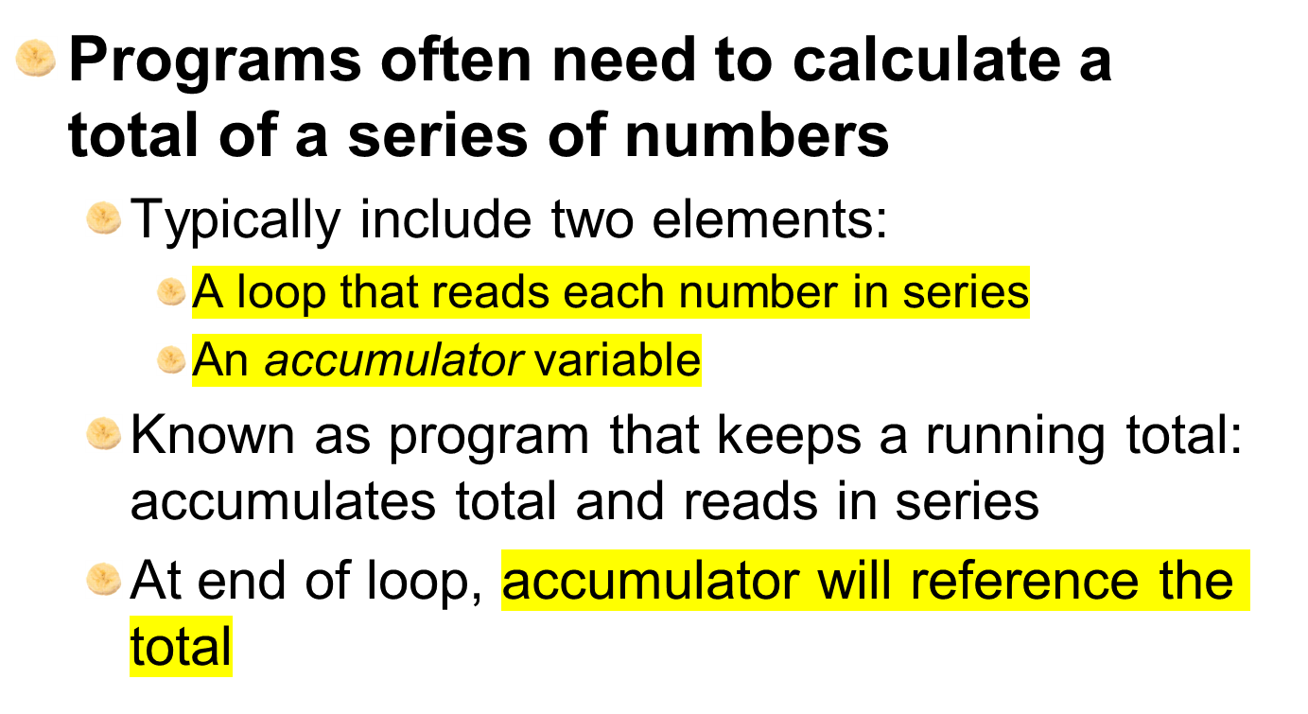
Calculating a Running Total

Slide 16
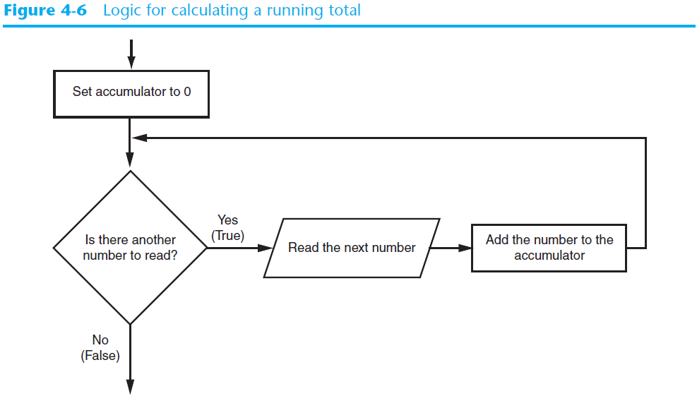
Calculating a Running Total (cont’d.)

Slide 17

In many assignment statements, the variable on the left side of the = operator also appears on the right side of the = operator
Augmented assignment operators: special set of operators designed for this type of job
  Shorthand operators

Slide 18
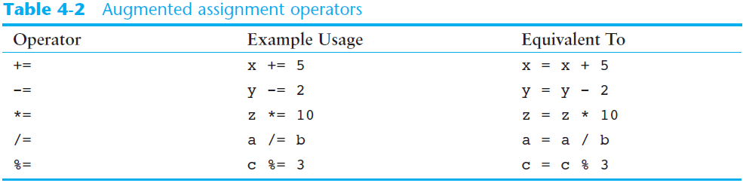
The Augmented Assignment Operators (cont’d.)

Slide 19
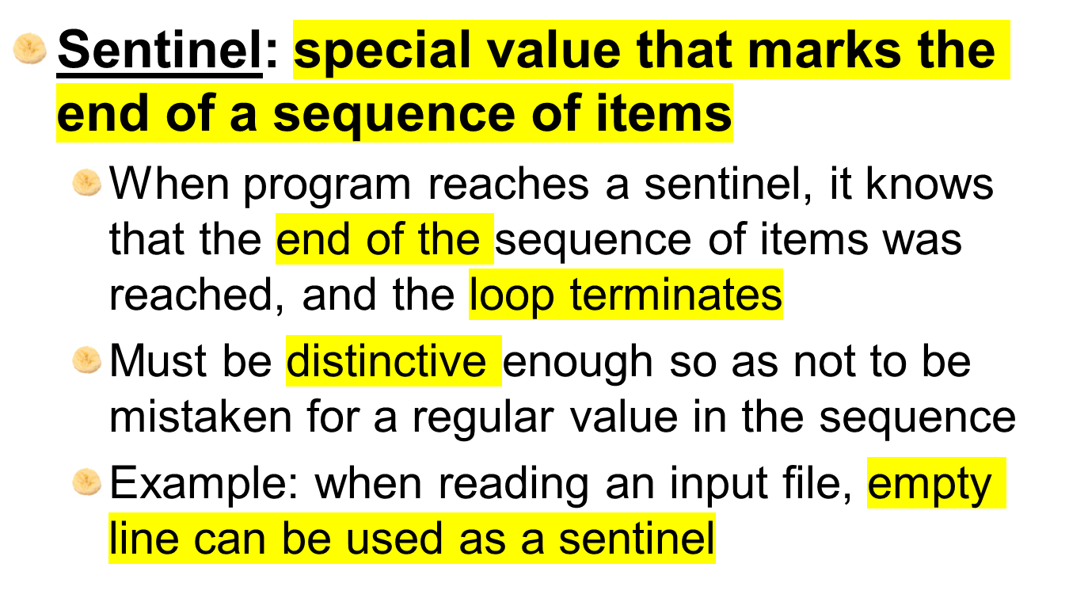
Sentinels

Slide 20
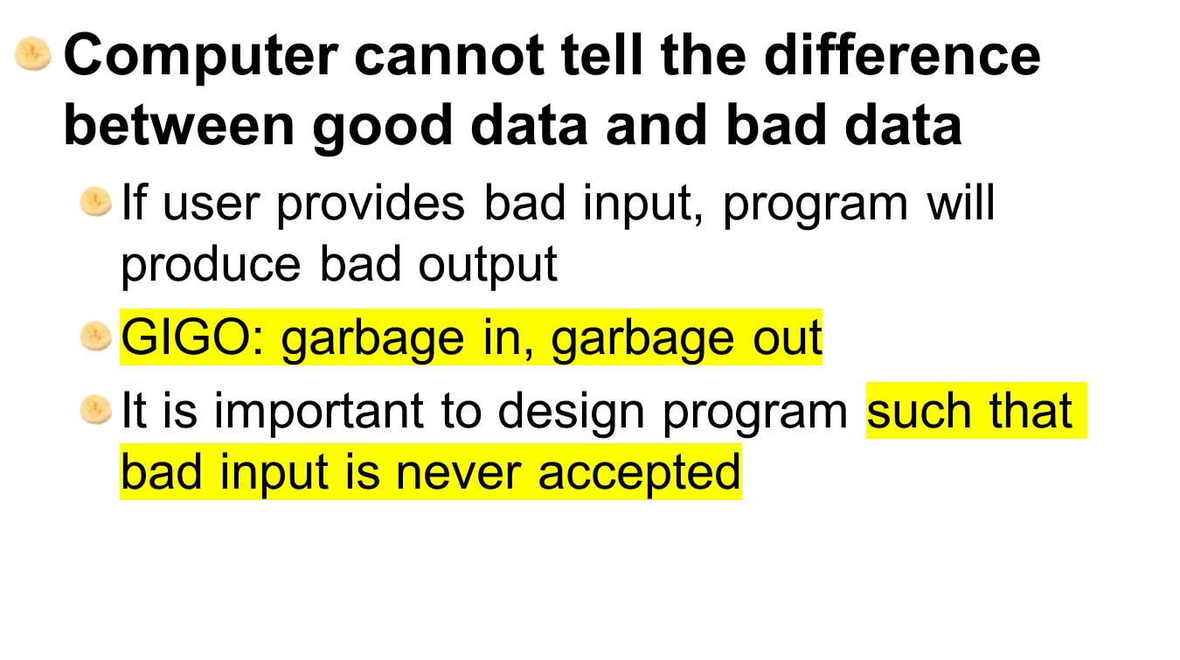
Input Validation Loops

Slide 21
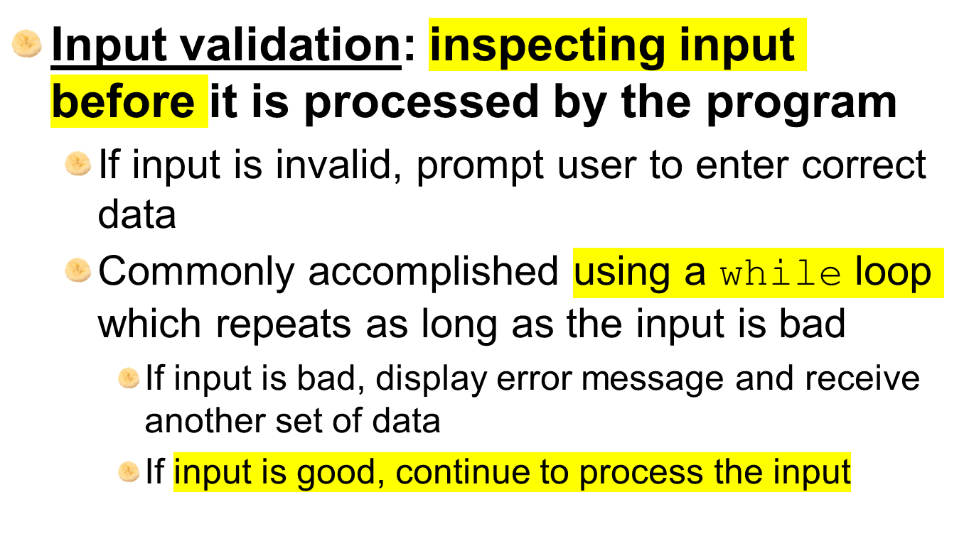
Input Validation Loops (cont’d.)

Slide 22
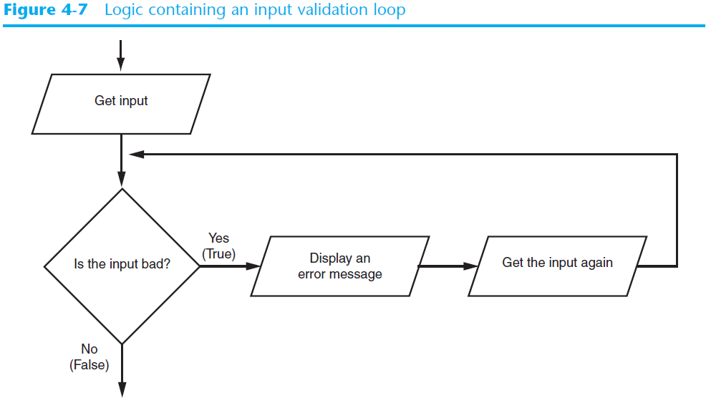
Input Validation Loops (cont’d.)

Slide 23
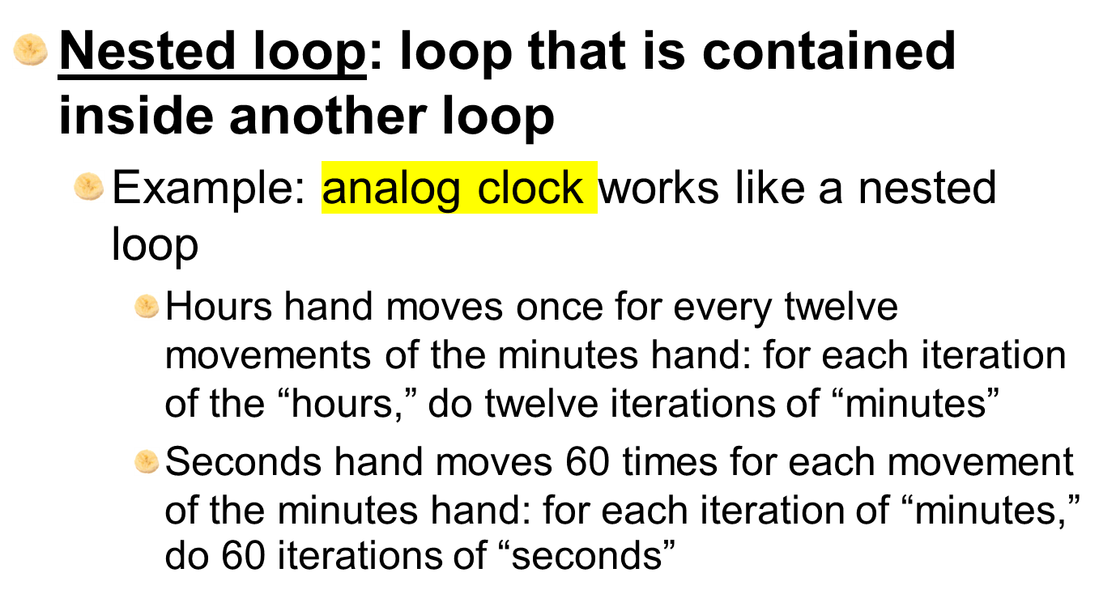
Nested Loops

Slide 24
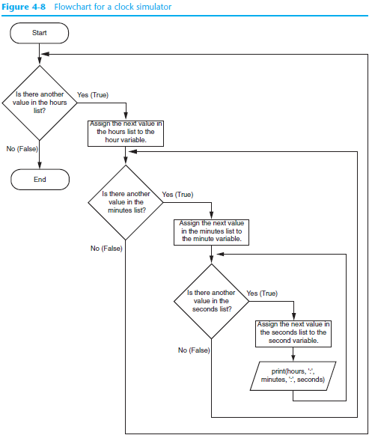

Slide 25
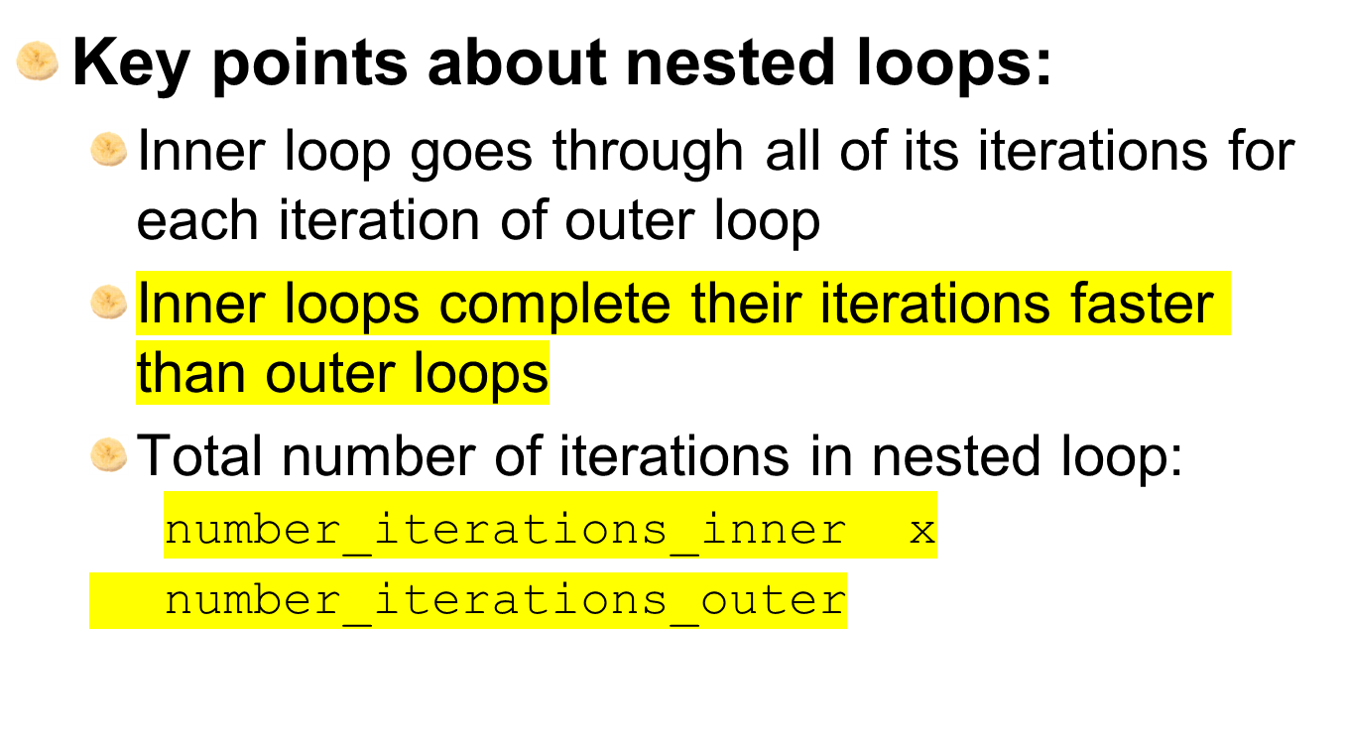
Nested Loops (cont’d.)

Slide 26
Summary
This chapter covered:
  Repetition structures, including:
    Condition-controlled loops
    Count-controlled loops
    Nested loops
  Infinite loops and how they can be avoided
  range function as used in for loops
  Calculating a running total and augmented assignment operators
  Use of sentinels to terminate loops

